Slide 1
Computer Organization and Architecture Activity

Slide 2
Problem statement
Write an assembly program to multiply two numbers one of which is in memory location x and the other is in processor register R1 using booths algorithm. Store the result back in memory location y . Design a RISC based data path for the above and simulate the same using suitable tool.

Slide 3
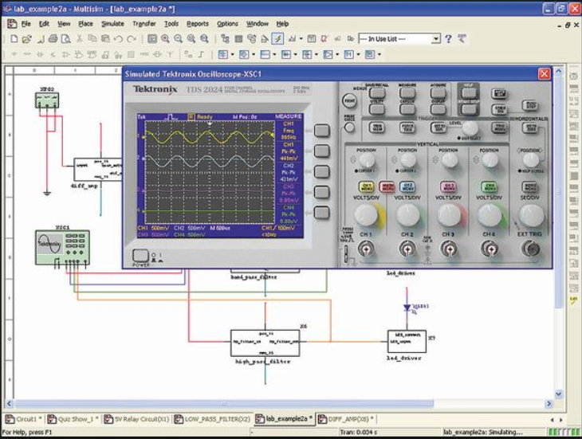
Survey on simulation tools
Some of the simulation tools we surveyed on are:
MultiSim – It includes microcontroller simulation as well as integrated import and export features to the printed circuit board layout software, which makes it easy to use in academia for circuit education.
PySpice- Its an open source python module
which interface Python to the Ngspice and Xyce
circuit simulators.

Slide 4
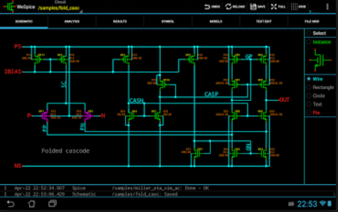
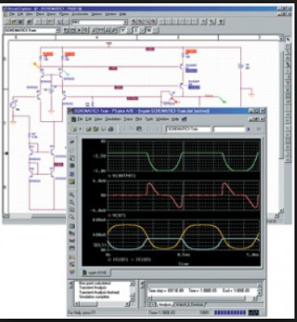
Ngspice-Its an open source mixed signal circuit simulator.
Proteus-a proprietary software
tool suite used primarily for electronic
design automation. The software is
Used mainly by electronic design
engineers and technicians to create
schematics and electronic prints for
manufacturing printed circuit boards.

Slide 5
Logisim –It’s a simulator which permits circuits to be designed and simulated using graphical user interface. It’s a java application that can run on both windows and Linux.
We chose Logisim as our simulation tool because :
Provides easy to use graphical environment.
Easy to follow and to simulate.
Flexible
Unlike most of the simulators it allows the user to edit the circuit during simulation.
It has a much wider set of features and tools.
Has all the required components

Slide 6
Brief description
Booths algorithm is used to obtain the product of two unsigned numbers by the method of recoding of multiplier.
In this method the multiplier is recoded from right to left bit by bit. Accordingly the multiplicand is multiplied with the recoded multiplier.
Partial products are obtained in each bit multiplication.
All the partial products will be added in the end to get the required product.

Slide 7
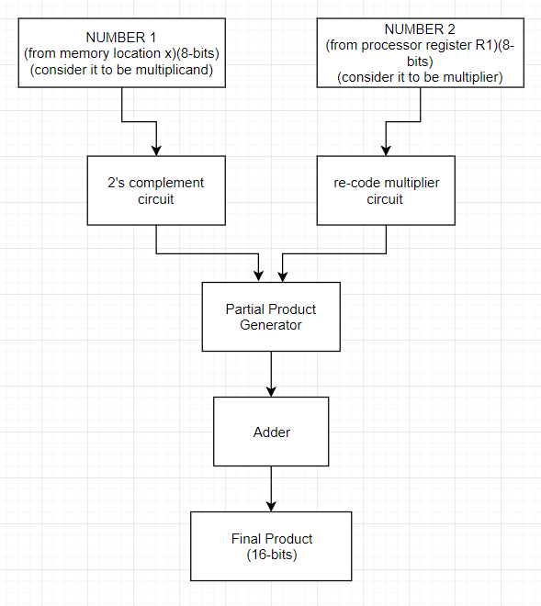
Block diagram

Slide 8
Functionalities of the components
D –flip –flops – To store the multiplicand and multiplier bits .
Comparators – To recode the multiplier.
Shifters - For left shifting .
Registers- To store all the partial products.
Adders – To add all the partial products and to get the required product.
Some other components are :
Counters – Used to give input to the shifter

Slide 9
Multiplexers – Takes the recoded multiplier as the input and multiply with the multiplicand.
Demultiplexers – To store each partial product obtained during each clock pulse into the registers.

Slide 10
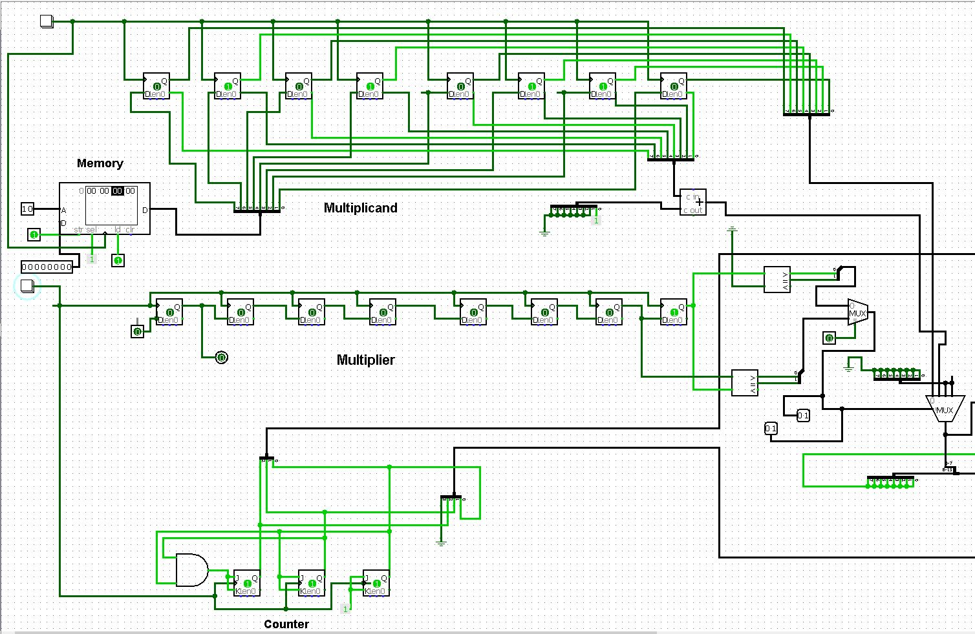
Data-Path 1

Slide 11
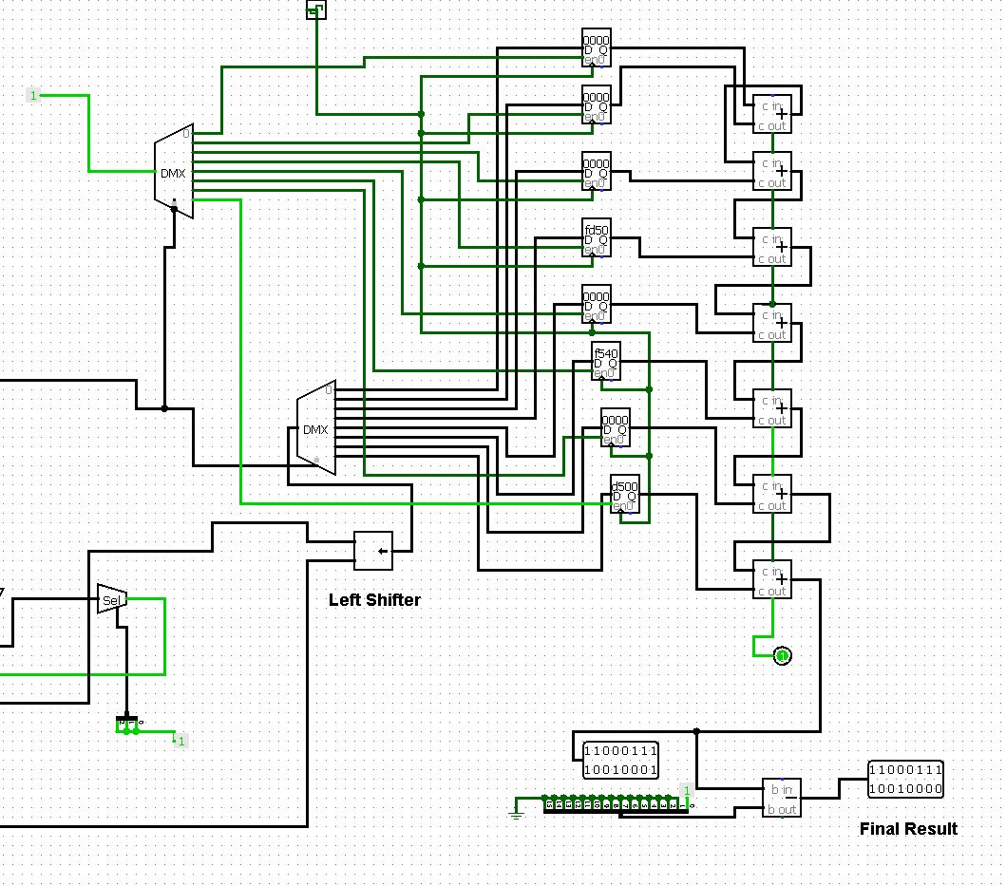
Data-Path 2

Slide 12
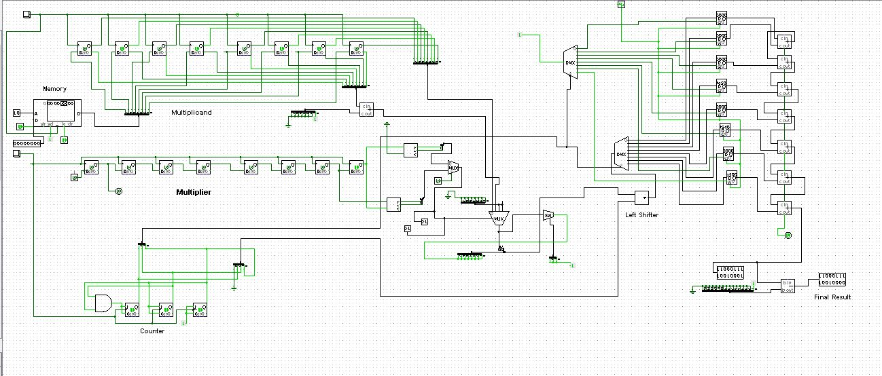
Datapath

Slide 13
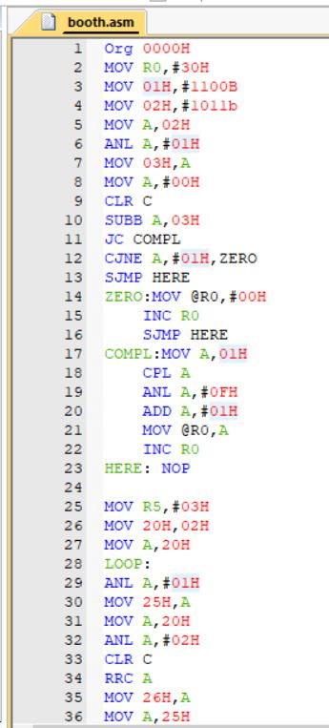
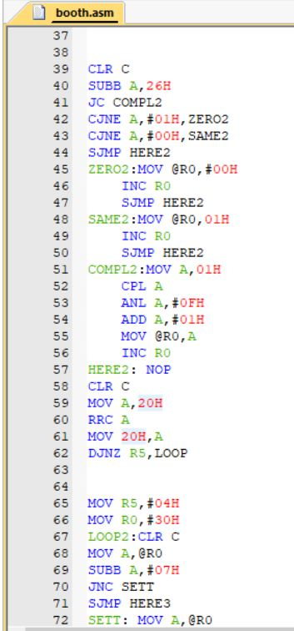
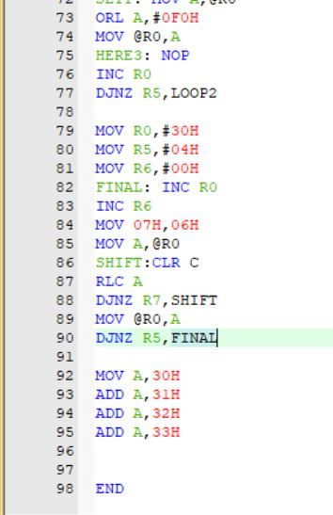
Assembly language code

Slide 14
Thank You

